Slide 1




Slide 2






Slide 3


Definition:

Slide 4
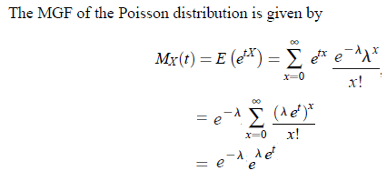

M.G.F, Mean and Variance of Poisson Distribution

Slide 5
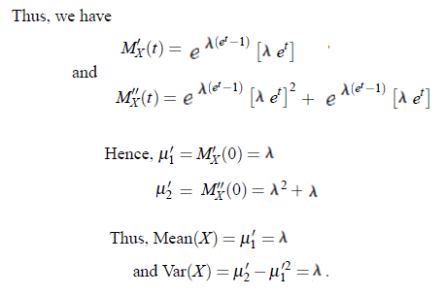


Slide 6
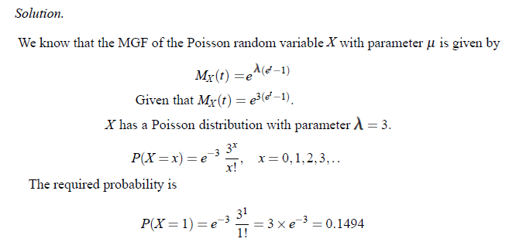
Problem: 1

Slide 7
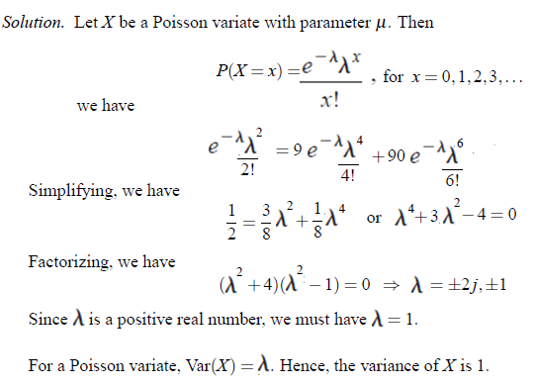
Problem: 2

Slide 8

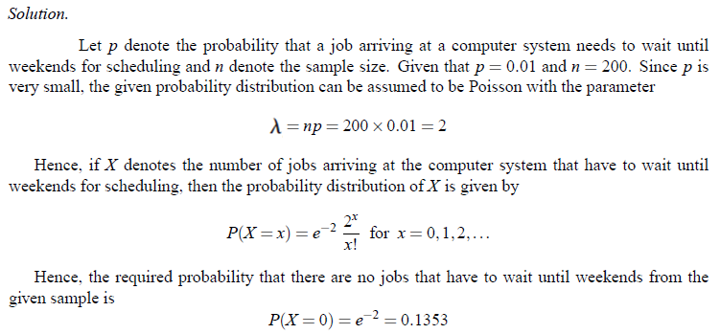
Problem: 3

Slide 9



Problem: 4

Slide 10
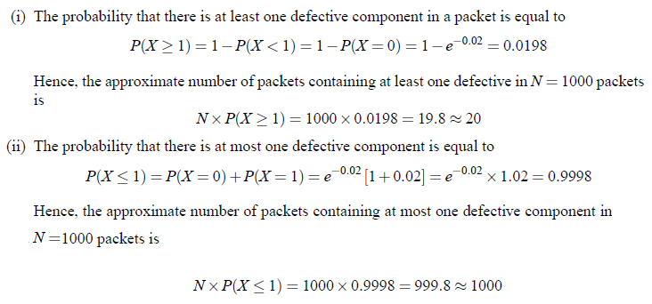

Slide 11

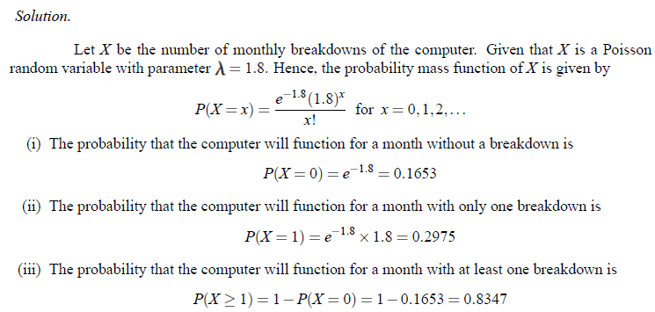
Problem: 5

Slide 12
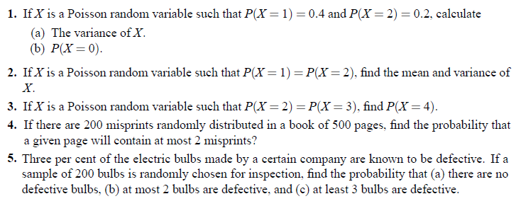
Problems for Practice

